Slide 1

Thread

Slide 2

Outlines of Presentation
Thread
Multithread
Synchronization
Deadlock
Thread scheduling

Slide 3
Thread
A Thread is similar to a program that has a single flow of control
On the other hand, threads are independent processes that can be run simultaneously
It has
  A beginning
  A body and an end
  Executes command sequentially
Class abc
{
----------------
----------------
-----------------
}
Beginning
Single- threaded
body of execution
End
Single Threaded Program

Slide 4

Multitasking and Multithreading
Multitasking:
  refers to a computer's ability to perform multiple jobs concurrently.
  more than one program are running concurrently, e.g., UNIX.
Multithreading:
  A thread is a single sequence of execution within a program.
  refers to multiple threads of control within a single program.
  each program can run multiple threads of control within it, e.g., Web Browser.

Slide 5
Multithread programming
Java enable us to use Multiple flows of control in developing programs
Each flow of control may be thought of as separate tiny program known as a thread that runs parallel
A program that contains multiple flows of control is known a multiplethreaded program
Main Thread
--------------------------------------------------------
Main method
module
start
------------------------------------------
------------------------------------------
------------------------------------------
switching
switching
Thread A
Thread B
Thread C

Slide 6
Creating Threads
Threads are implemented in the form of objects that contain a method called run()
The run method is the heart and soul of any thread
It makes up the entire body of a thread and is the only method in which the thread’s behavior can be implemented
Java contains two slightly different ways of implementing a thread
  Implementing the runnable interface
  Extending the thread class
Notes:
Link: 1. Abstract Class(https://beginnersbook.com/2013/05/java-abstract-class-method/)
2. Interface Class(https://beginnersbook.com/2013/05/java-interface/)

Slide 7
Creating Threads
Runnable
  This is the barebones thread implementation
  There is only a single method named run() that need to be implemented
Thread
  This is the Roll-Royce model that contains everything
  Like Runnable, the run() method in the only one that needs to be implemented by any extended class
  However, it is not an abstract method, so even that is not required
Notes:
Barebones: reduced to or comprising only the basic or essential elements of something.

Slide 8

Example of Implementing the Runnable Interface
class NewThread implements Runnable{
Thread t;
NewThread() {
t = new Thread (this,"Demo Thread");
System.out.println ("Child thread:" +t);
t.start () ;//start the thread
}
public void run(){
try{
for (int i=5; i>0; i--){
System.out.println("child thread:"+i);
Thread.sleep(500);
}
}catch (InterruptedException e){
System.out.println("child interrupted.");
}
System.out.println("exiting child thread.");
}
}
class wc{
public static void main (String args[]){
new NewThread(); //creatr a new thread
try{
for(int i=5; i>0; i--){
System.out.println("main thread:"+i);
Thread.sleep(1000);
}
}catch (InterruptedException e){
System.out.println ("main thread interrupted.");
}
System.out.println("main thread exiting.");
}
}
Notes:
Link: https://www.w3schools.com/java/ref_keyword_this.asp#:~:text=The%20this%20keyword%20refers%20to,a%20method%20or%20constructor%20parameter).

Slide 9
Extending the thread class
It can make the class runnable as a thread by extending the class java.lang.Thread
It includes the following steps
  Declare the class as extending the tread class
  Implement the run() method that is responsible for the sequence of code that the thread will execute
  Create a thread object and call the start() method to initiate the tread execution
    Class MyThread extends Thread
    {
    ------
    }
    Public void run()
    {
    ------
    }
    MyThread aThread = newMyThread();
    aThread.start(); //invoke run() method

Slide 10
Example of Extending the Thread Class
class A extends Thread
{
public void run()
{
for(int i=1; i<=5; i++)
{
System.out.println ("\t from yhread A: i="+i);
}
System.out.println("exit from A");
}
}
class B extends Thread
{
public void run()
{
for(int j=1; j<=5; j++)
{
System.out.println ("\t from yhread B: j="+j);
}
System.out.println("exit from B");
}
}
class C extends Thread
{
public void run()
{
for(int k=1; k<=5; k++)
{
System.out.println ("\t from yhread C:ki="+k);
}
System.out.println("exit from C");
}
}
class wc
{
public static void main(String args[])
{
new A ().start();
new B ().start();
new C ().start();
}
}

Slide 11
Stopping and blocking a thread
Stopping a thread
  If we want to stop a thread from running further, we may do so calling its stop() method
  aThread.stop()
  This statement causes the thread to move to the dead state
  A thread will also move to the dead state automatically when it reaches the end of its method
  The stop() method may be used when the premature death of a thread is desired
Blocking a thread
  A thread can also be temporarily suspended or blocked from entering in to the runnable and sub sequentially running state by using the following thread method
    Sleep() //block from the specified time
    Suspended() //block until further order specified time
    Wait() //block until certain condition occurs

Slide 12
Life Cycle of a Thread
During the life time of a thread, there are many states it can enter. They include
  Newborn state
  Runnable state
  Running state
  Blocked state
  Dead state
A thread is always in one of these five states
It can move from one state to another via a variety of ways

Slide 13
Life Cycle of a Thread
.
Newborn
stop
start
Running
Runnable
Active
Thread
stop
Dead
Killed
Thread
yield
stop
suspend
sleep
wait
resume
notify
Idle Thread
(Not Runnable)
Blocked

Slide 14
Newborn State
Newborn
Start
Stop
Runnable
state
Dead
state
When we create a thread object, the thread is born and is said to be in newborn state
The thread is not yet scheduled for running
At this state, we can do one of the following
  Schedule it for running using start() method
  Kill it using stop() method
If schedule, it moves to the runnable state

Slide 15
Runnable State
Yield
Running Thread
Runnable State
The runnable state means that the thread is ready for execution and is waiting for the availability of the processor
If all threads have equal priority, then they are given time slots for execution in round robin fashion, i.e, first come first serve manner
This process of assigning time to thread is known as time slicing
However, if we want a thread to relinquish control to another thread of equal priority before its turn comes, we can solve by using the yield() method

Slide 16
Running State
Running means that the processor has given its time to the thread for its execution
The thread runs until it relinquishes control on its own or it is preempted by a higher priority thread
A running thread may relinquish its control in one of the following
Suspended
Resume
Running
Runnable
Suspended
Sleep(t)
After t
Running
Runnable
Sleeping
Waiting
Notify
Running
Runnable
Waiting

Slide 17
Blocked and Dead State
Blocked state
  A thread is said to be blocked when it is prevent from entering into the runnable state and subsequently the running state
  This happens when the thread is suspended, sleeping , or waiting in order to satisfy certain requirements
  A block thread is considered “not runnable” but not dead and therefore fully qualified to run again
Dead state
  A running thread ends its life when it has completed executing its run() method. It is a natural death
  However, we can kill it by sending the stop() message to it at any state thus causing a premature death to it.
  A thread can be killed as soon it is born, or while it is running, or even when it is in “not runnable” condition

Slide 18
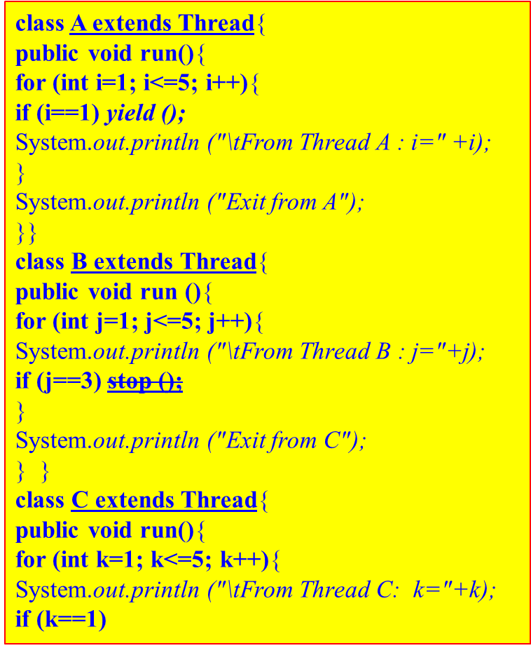
Example
try{
sleep (1000);
}
catch (Exception e)
{ } }
System.out.println ("Exit from C");
} }
class lifecycle{
public static void main (String args[]){
A threadA= new A();
B threadB=new B ();
C threadC= new C ();
System.out.println ("Start thread A");
threadA.start();
System.out.println ("Start thread B");
threadB.start();
System.out.println ("Start thread C");
threadC.start();
System.out.println ("End of main thread");
}
}

Slide 19
Synchronization
Java supports multiple threads to be executed
This may cause two or more threads to access the same fields or objects
Synchronization control the access the multiple threads to a shared resources
Synchronization is the process of allowing threads to execute one after another

Slide 20
Synchronization
Without synchronization of threads, one thread can modify a shared variable while another thread can update the same shared variable, which leads to significant errors
Synchronization avoids memory consistence errors caused due to inconsistent view of shared memory
When a method is declared as synchronized
  The thread holds the monitor for that method's object if another thread is executing the synchronized method, that thread is blocked until that thread releases the monitor

Slide 21
Synchronization
This is the general form of the synchronized statement:
Here, object is a reference to the object being synchronized
A synchronized block ensures that a call to a method that is a member of object occurs only after the current thread has successfully entered object's monitor
synchronized(object)
{
// statements to be synchronized
}

Slide 22
Example
// File Name : Callme.java
class Callme {
void call(String msg) {
System.out.print("[" + msg);
try {
Thread.sleep(1000);
} catch (InterruptedException e) {
System.out.println("Interrupted"); }
System.out.println("]");
} }
// File Name : Caller.java
class Caller implements Runnable {
String msg; Callme target; Thread t;
public Caller(Callme targ, String s) {
target = targ;
msg = s;
t = new Thread(this);
t.start(); }
// synchronize calls to call()
public void run() {
//synchronized(target) { // synchronized block
target.call(msg);
// }
} }
// File Name : Synch.java
class sync {
public static void main(String args[]) {
Callme target = new Callme();
Caller ob1 = new Caller(target, "Hello");
Caller ob2 = new Caller(target, "Synchronized");
Caller ob3 = new Caller(target, "World");
// wait for threads to end
try {
ob1.t.join();
ob2.t.join();
ob3.t.join();
} catch(InterruptedException e) {
System.out.println("Interrupted");
} } }

Slide 23
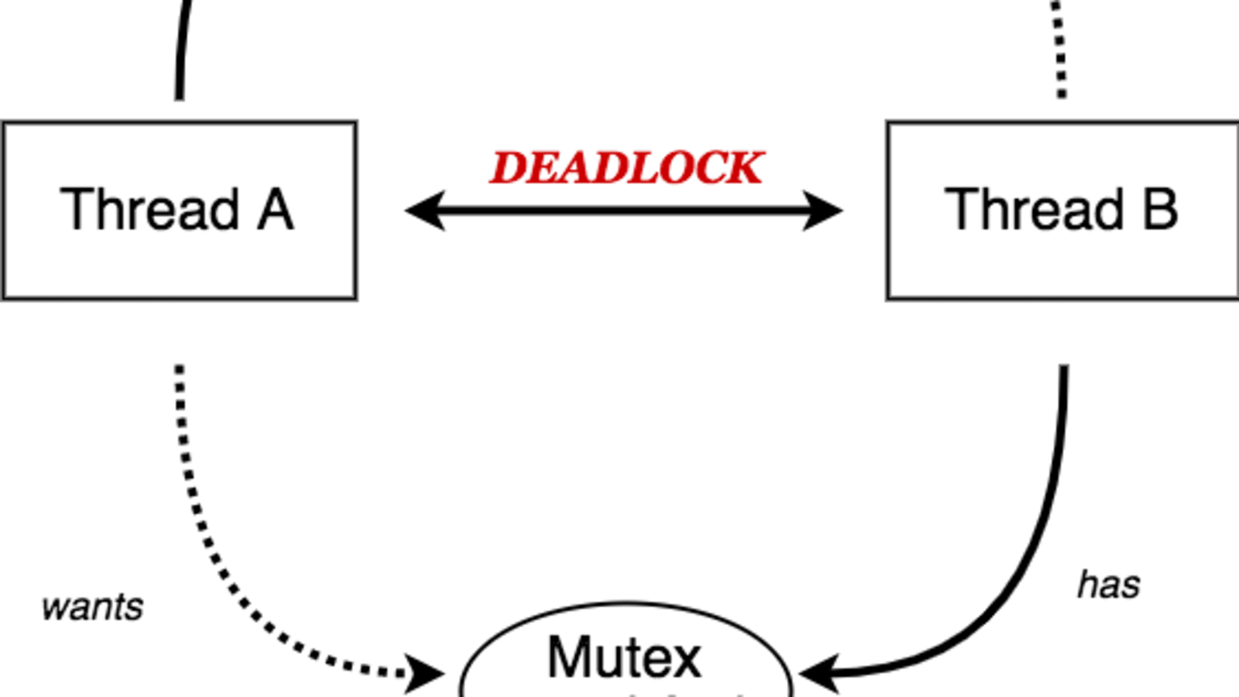
Deadlock
Deadlock: circular waiting for resources
  Thread A owns Res 1 and is waiting for Res 2
  Thread B owns Res 2 and is waiting for Res 1
Consider mutexes ‘x’ and ‘y’:
Thread A Thread B
x.P(); y.P();
y.P(); x.P();
Thread
A
Wait
For
Owned
By
Res 1
Res 2
Wait
For
Owned
By
Thread
B
Notes:
Mutex:(programming) An object in a program that serves as a lock, used to negotiate mutual exclusion (avoid) among threads.

Slide 24
Example
class A {
synchronized void foo(B b) {
String name = Thread.currentThread().getName();
System.out.println(name + " entered A.foo");
try {
Thread.sleep(1000);
} catch(Exception e) {
System.out.println("A Interrupted");
}
System.out.println(name + " trying to call B.last()");
b.last();
}
synchronized void last() {
System.out.println("Inside A.last");
}} class B {
synchronized void bar(A a) {
String name = Thread.currentThread().getName();
System.out.println(name + " entered B.bar");
try {
Thread.sleep(1000); }
catch(Exception e) {
System.out.println("B Interrupted");
} System.out.println(name + " trying to callA.last()");
a.last();
}
synchronized void last() {
System.out.println("Inside B.last");
}}
class Deadlock implements Runnable {
A a = new A();
B b = new B();
Deadlock() {
Thread.currentThread().setName("MainThread");
Thread t = new Thread(this, "RacingThread");
t.start();
a.foo(b); // get lock on a in this thread.
System.out.println("Back in main thread");}
public void run() {
b.bar(a); // get lock on b in other thread.
System.out.println("Back in other thread");}
public static void main(String args[]) {
new Deadlock();
}
}

Slide 25
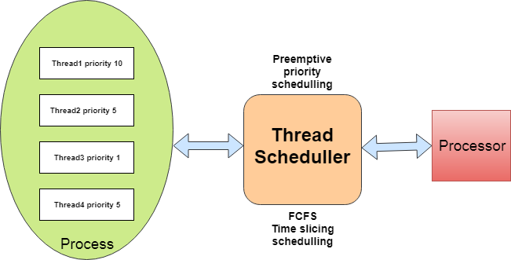
Scheduling
Thread scheduling is the mechanism used to determine how runnable threads are allocated CPU time.
A thread-scheduling mechanism is either preemptive (take action in order) or nonpreemptive.
Preemptive scheduling– the thread scheduler preempts (pauses) a running thread to allow different threads to execute.
Nonpreemptive scheduling – the scheduler never interrupts a running thread.
The nonpreemptive scheduler relies on the running thread to yield control (give hints) of the CPU so that other threads may execute.
Notes:
Thread Scheduler: A component of Java that decides which thread to run or execute and which thread to wait is called a thread scheduler in Java.
Non preemptive: Thread. yield method gives hint to the thread scheduler that it is ready to pause its execution. The thread scheduler is free to ignore this hint. If any thread executes the yield method, the thread scheduler checks if there is any thread with the same or high priority as this thread.

Slide 26
Starvation
A nonpreemptive scheduler may cause starvation (runnable threads, ready to be executed, wait to be executed in the CPU a very long time, maybe even forever).
Sometimes, starvation is also called a livelock.

Slide 27
Time-Sliced Scheduling
Time-sliced scheduler
  the scheduler allocates a period of time that each thread can use the CPU.
  when that amount of time has elapsed (crossed), the scheduler preempts the thread and switches to a different thread.
Nontime-sliced scheduler
  the scheduler does not use elapsed time to determine when to preempt a thread.
  it uses other criteria such as priority or I/O status.

Slide 28
Java thread scheduling
The highest priority runnable thread is always selected for execution above lower priority threads.
In general, the runnable thread with the highest priority is active (running)
Java is priority-preemptive
  If a high-priority thread wakes up, and a low-priority thread is running
  Then the high-priority thread gets to run immediately
Allows on-demand processing

Slide 29
Thread Priority
Every thread has a priority.
When a thread is created, it inherits the priority of the thread that created it.
The priority values range from 1 to 10, in increasing priority.
The priority can be adjusted subsequently using the setPriority() method.
The priority of a thread may be obtained using getPriority()
Priority constants are defined:
    MIN_PRIORITY=1
    MAX_PRIORITY=10
    NORM_PRIORITY=5
The main thread is
created with priority
NORM_PRIORITY

